Slide 1
CIS 9557 – Business Analytics
Week 3 Exploratory Data Analysis
Prof. Arturo Castellanos
CIS Department Office: VC11-B242

Slide 2
Practical Definition
“Data visualization is the presentation of data in a graphical format”

Slide 3

“You can observe a lot by watching”
Yogi Berra (1925-2015)

Slide 4
Pros and Cons of Summary Statistics
Pros:
Report key facts on historical data
Aid in understanding the data
Cons:
Statistics value can be deceiving
i.e: age 17, 18, 19, 23, 22, 87
Mean=31
Median: 20.5

Slide 5
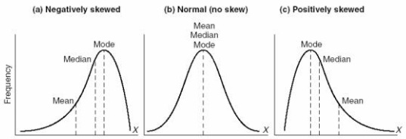
STATS: Skewness
Skewness is a measure of the asymmetry of the probability distribution of a real-valued random variable about its mean. The skewness value can be positive or negative, or even undefined.
Source: Wikipedia
Positive:
Income,
Mileage on used cars for sale,
House prices
Negative:
Scores on an easy test,
scores on a test that a student are motivated,
Age at death in developed countries
Notes:
London 2012 Men's Long Jump qualifying round results

Slide 6
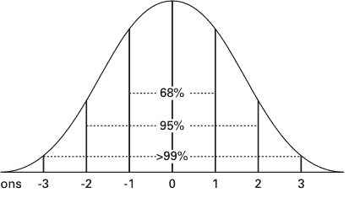
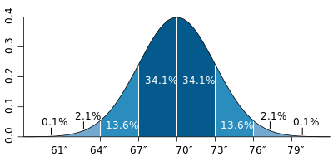
Example:
The average height for adult men in the United States is about 70 inches, with a standard deviation of around 3 inches.
Notes:
As a slightly more complicated real-life example, the average height for adult men in the United States is about 70 inches, with a standard deviation of around 3 inches. This means that most men (about 68%, assuming a normal distribution) have a height within 3 inches of the mean (67–73 inches) – one standard deviation – and almost all men (about 95%) have a height within 6 inches of the mean (64–76 inches) – two standard deviations. If the standard deviation were zero, then all men would be exactly 70 inches tall. If the standard deviation were 20 inches, then men would have much more variable heights, with a typical range of about 50–90 inches. Three standard deviations account for 99.7% of the sample population being studied, assuming the distribution is normal (bell-shaped).

Slide 7
A SCHOLARLY TAXONOMY FOR DATA VISUALIZATION:
TASKS:
Overview: high level
Zoom-in: on items of interest
Filter: filter out uninteresting patterns
Details-on-demand: select an item or group and get details when needed
Relate: view relationships among items
History: Keep a history of actions to support undo, replay, and progressive refinement.
Extract: allow extraction of sub-collections and of the query parameters.
Source: Shneiderman, B. (1996, September). The eyes have it: A task by data type taxonomy for information visualizations. In Visual Languages, 1996. Proceedings., IEEE Symposium on (pp. 336-343)
Notes:
Nominal categorical variables, however, often cannot be used as is. In many cases they must be decomposed into a series of binary variables, called dummy variables. For example, a single categorical variable that can have possible values of “student,” “unemployed,” “employed,” or “retired” would be split into four separate dummy variables:
Student—Yes/No
Unemployed—Yes/No
Employed—Yes/No
Retired—Yes/No

Slide 8
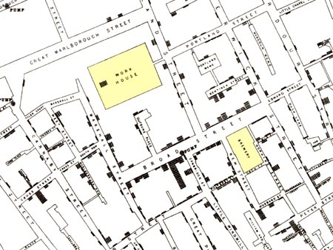
Why Viz? 1. London Cholera Epidemic
Illustration of John Snow’s deduction that a cholera epidemic was caused by a bad water pump, circa 1854. The bar graphs represents the number of deaths in that location.
Notes:
Source: From Visual Explanations by Edward Tufte, Graphics Press, 1997

Slide 9
Possible Goals in Visualization
1. Presentation (reporting & story-telling)
2. Exploration and preliminary analysis
Our focus here is mainly #2.

Slide 10
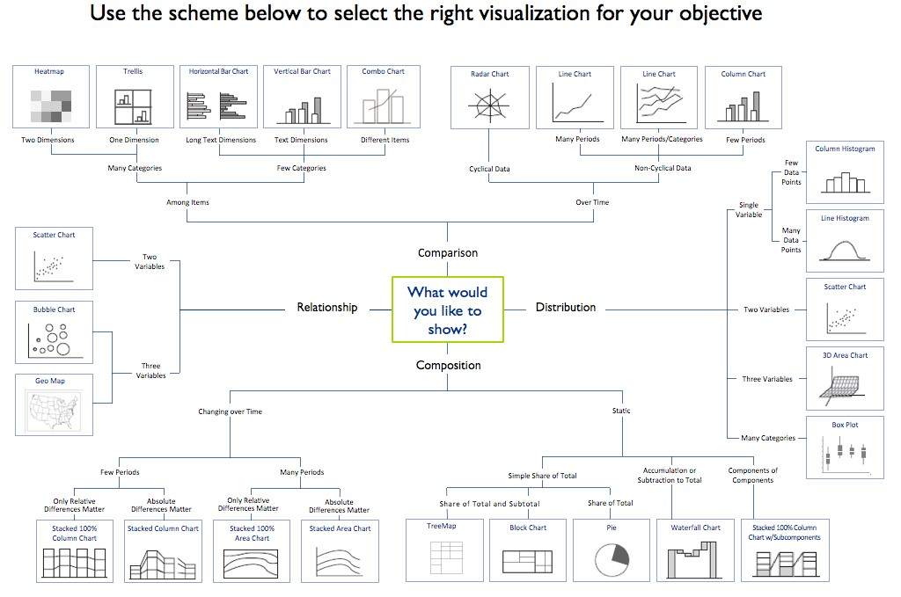
1. Presentation (answering business questions)
Source: http://www.winwire.com/data-visualization/

Slide 11
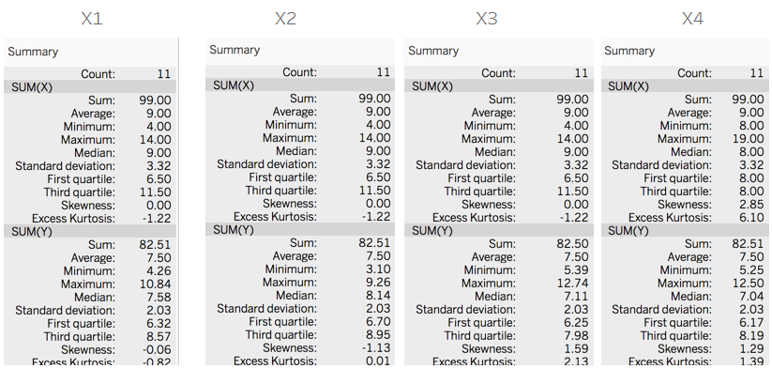
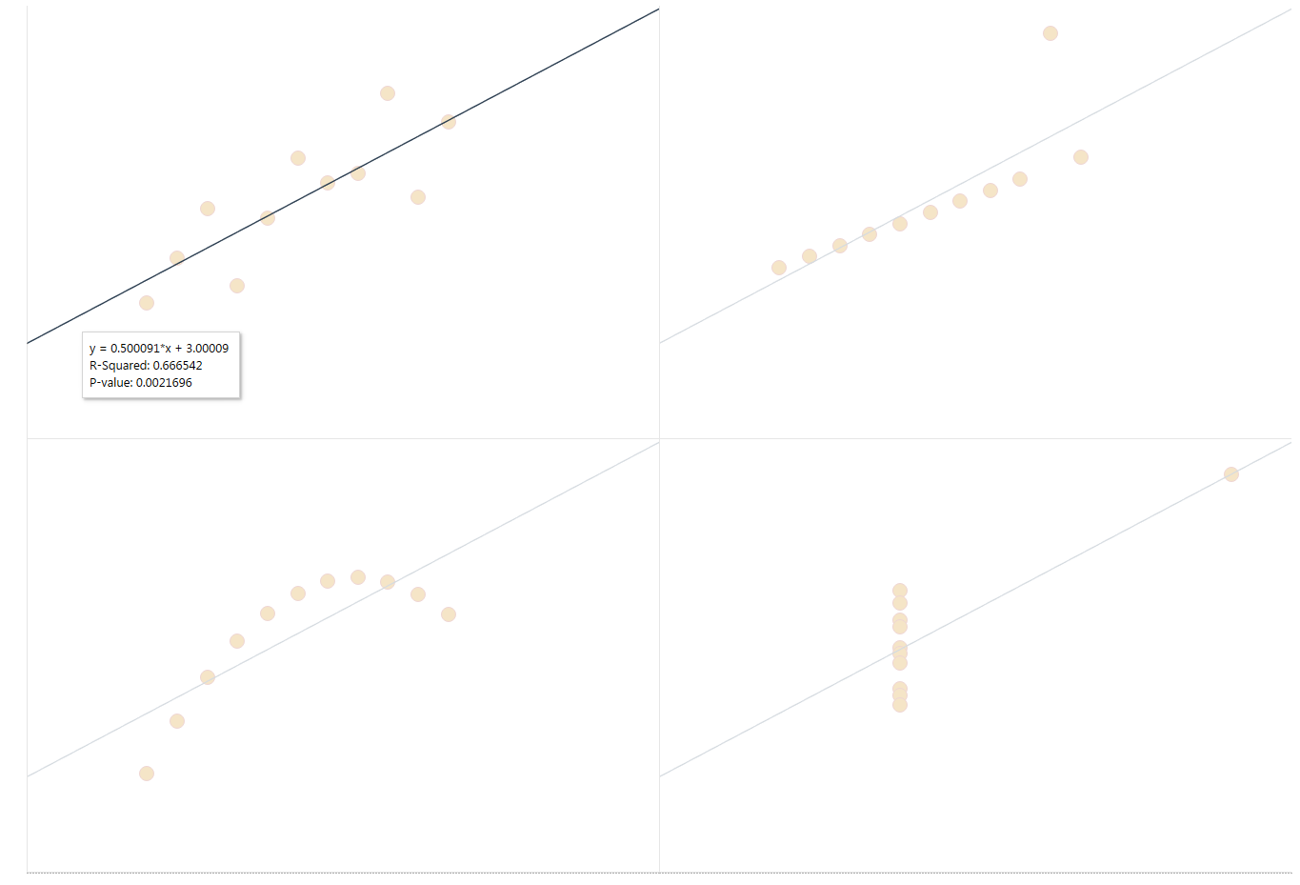
Why Viz? 2. Anscombe’s Quartet (Outliers)
outlier
outlier
Non-linear relationship yet high correlation coefficient
Anscombe’s quartet comprises four datasets that have nearly identical simple statistical properties, yet appear very different when graphed. This demonstrates the importance of graphing data before analyzing it and the effect of outliers on statistical properties.

Slide 12
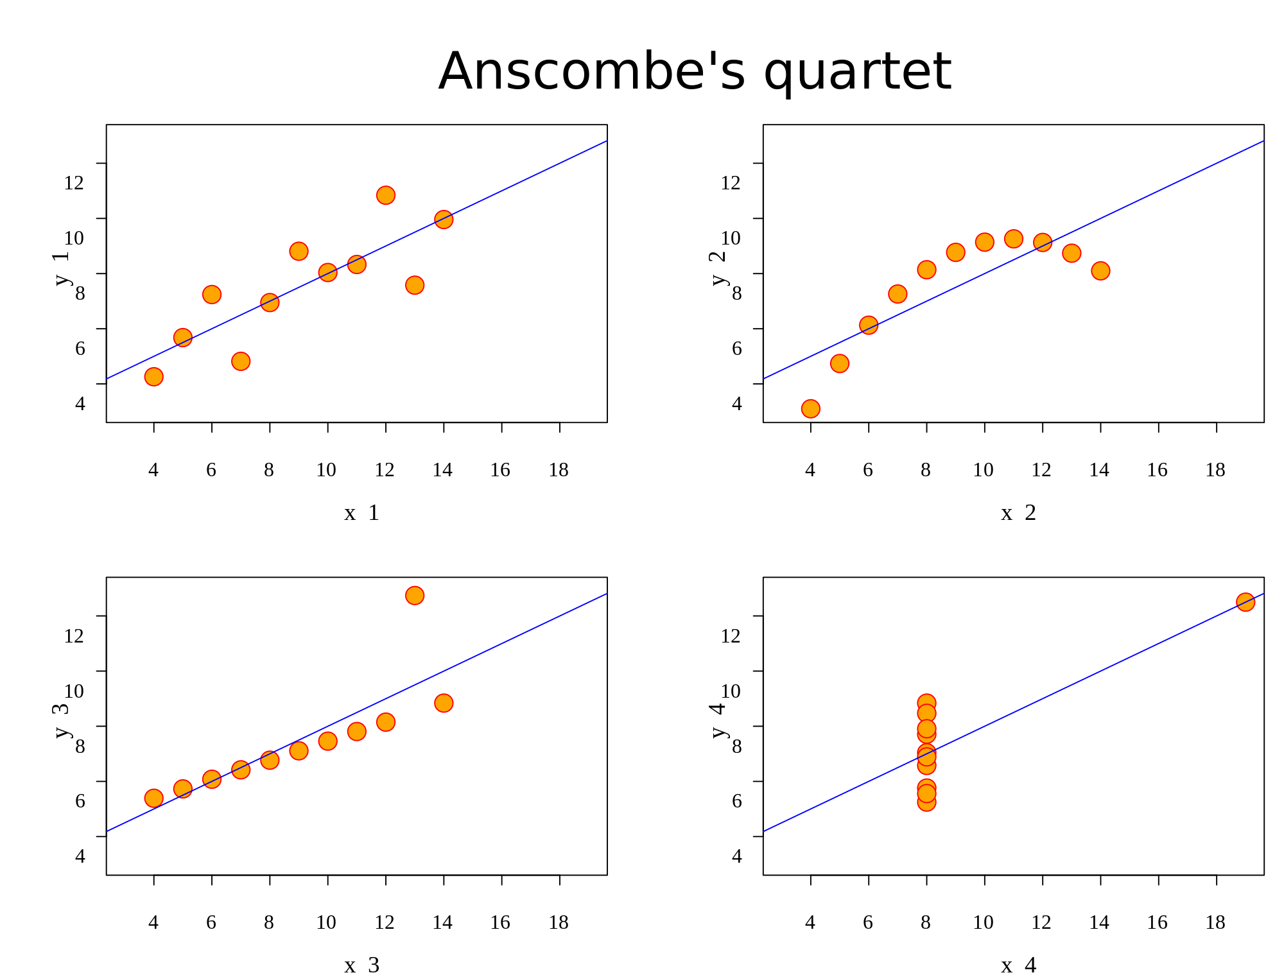

Slide 13
Python Libraries
matplotlib - oldest and most flexible
seaborn, pandas - wrappers around matplotlib; help create plots quickly, but knowledge of matplotlib allows better control over final plot

Slide 14
Plots for Data Exploration
Basic Plots
Line Graphs
Bar Charts
Scatterplots
Distribution Plots
Boxplots
Histograms

Slide 15
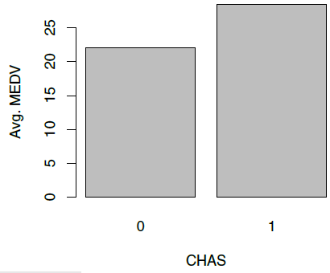
Bar Chart for Categorical Variable Average median neighborhood value for neighborhoods that do and do not border the Charles River

Slide 16
Alternative Codes for Bar Chart
CHAS vs. mean MEDV
Using matplotlib:
# compute mean MEDV per CHAS = (0, 1)
dataForPlot = housing_df.groupby('CHAS').mean().MEDV
fig, ax = plt.subplots()
ax.bar(dataForPlot.index, dataForPlot, color=['C5', 'C1'])
ax.set_xticks([0, 1], False)
ax.set_xlabel('CHAS')
ax.set_ylabel('Avg. MEDV')

Slide 17
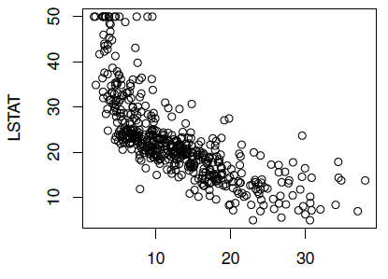
Scatterplot Displays relationship between two numerical variables
MEDV

Slide 18
Distribution Plots
Display “how many” of each value occur in a data set
Or, for continuous data or data with many possible values, “how many” values are in each of a series of ranges or “bins”

Slide 19
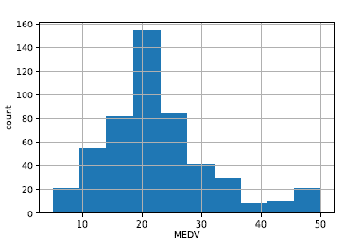
Histograms
Boston Housing example:
Histogram shows the distribution of the outcome variable (median house value)
About 20 neighborhoods had a median house value in the lowest bin, about $4000K to $9500 (these data are from mid-20th century)
## histogram of MEDV
ax = housing_df.MEDV.hist()
ax.set_xlabel('MEDV'); ax.set_ylabel('count')

Slide 20
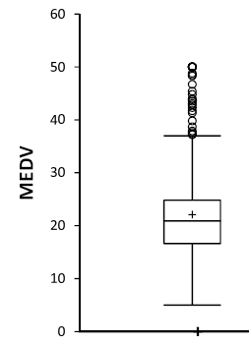
Box Plot
Top outliers defined as those above Q3+1.5(Q3-Q1).
“max” = maximum of non-outliers
Analogous definitions for bottom outliers and for “min”
Details may differ across software
outliers
“max”
Quartile 3
Median
Quartile 1
“min”

Slide 21
Alternative Codes for Scatterplot
Using pandas:
## scatter plot with axes names
housing_df.plot.scatter(x='LSTAT', y='MEDV', legend=False)
Using matplotlib:
## Set the color of points and draw as open circles.
plt.scatter(housing_df.LSTAT, housing_df.MEDV, color='C2', facecolor='none')
plt.xlabel('LSTAT'); plt.ylabel('MEDV')

Slide 22
Load Data to Illustrate Plots
## Load, convert Amtrak data for time series analysis
Amtrak_df = pd.read_csv('Amtrak.csv', squeeze=True)
Amtrak_df['Date'] = pd.to_datetime(Amtrak_df.Month,
format='%d/%m/%Y')
ridership_ts = pd.Series(Amtrak_df.Ridership.values,
index=Amtrak_df.Date)
## Boston housing data
housing_df = pd.read_csv('BostonHousing.csv')
housing_df = housing_df.rename(columns={'CAT. MEDV': 'CAT_MEDV'})

Slide 23
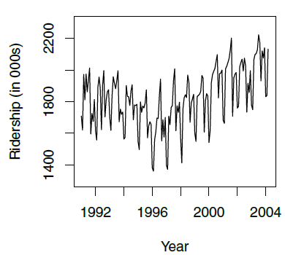
Line Plot for Time Series Amtrak Ridership

Slide 24
Alternative Codes for Line Plot
Using pandas:
ridership_ts.plot(ylim=[1300, 2300], legend=False)
plt.xlabel('Year') # set x-axis label
plt.ylabel('Ridership (in 000s)') # set y-axis label
Using matplotlib:
plt.plot(ridership_ts.index, ridership_ts)
plt.xlabel('Year') # set x-axis label
plt.ylabel('Ridership (in 000s)') # set y-axis label

Slide 25
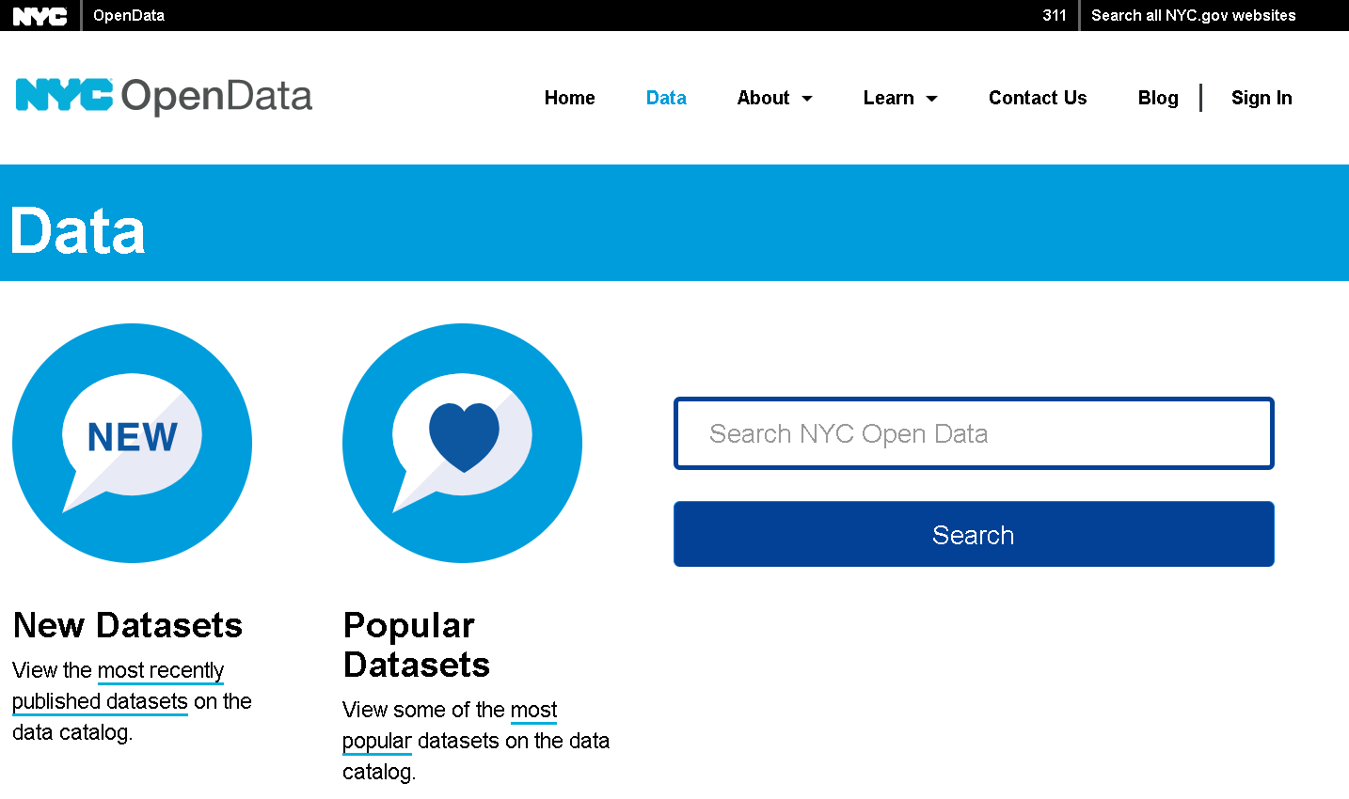
NYC Open Data Initiative

Slide 26
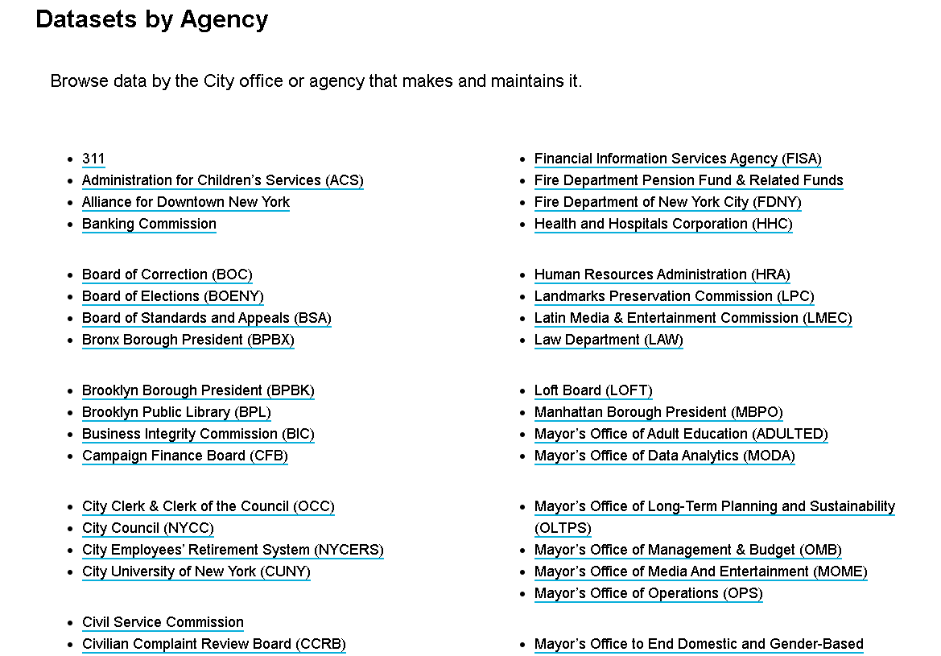
Examples:

Slide 27
Lab 1
Data reporting and visualization
Due 9/29 before class
Submit jupyter notebook
File -> save as -> Lab1-student-last-name_student-first-name.ipynb
Use your first and last name as they appear on Blackboard.

